Slide 1

ZINGERZ
TEAM 20
ARM-AI-SLOT-MACHINE
Notes:
Cadie

Slide 2

Phase 1 - Setup
Agent & Model
Rubric
App Quality
Playability
Visuals
Multi-modal features
Code Quality
Less lines of code
Separate files
Comments
Descriptive class/variable names
gemini-3.1-pro-preview
Notes:
Cadie
App quality Playability - how many features does it have, how easy is it to use
Visuals - how does it look, is it cohesive
Multi-modal features
Code Quality
Less lines of code
Separate files for HTML, CSS and JS (no file is too big)
Comments
Descriptive class names and variable names

Slide 3
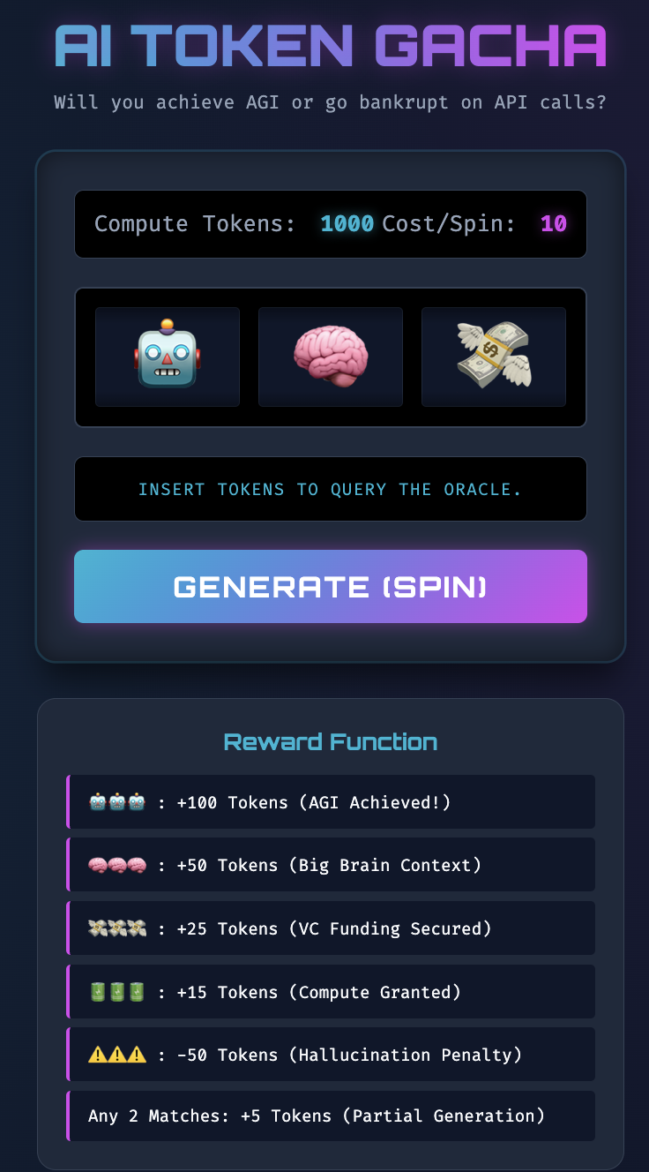
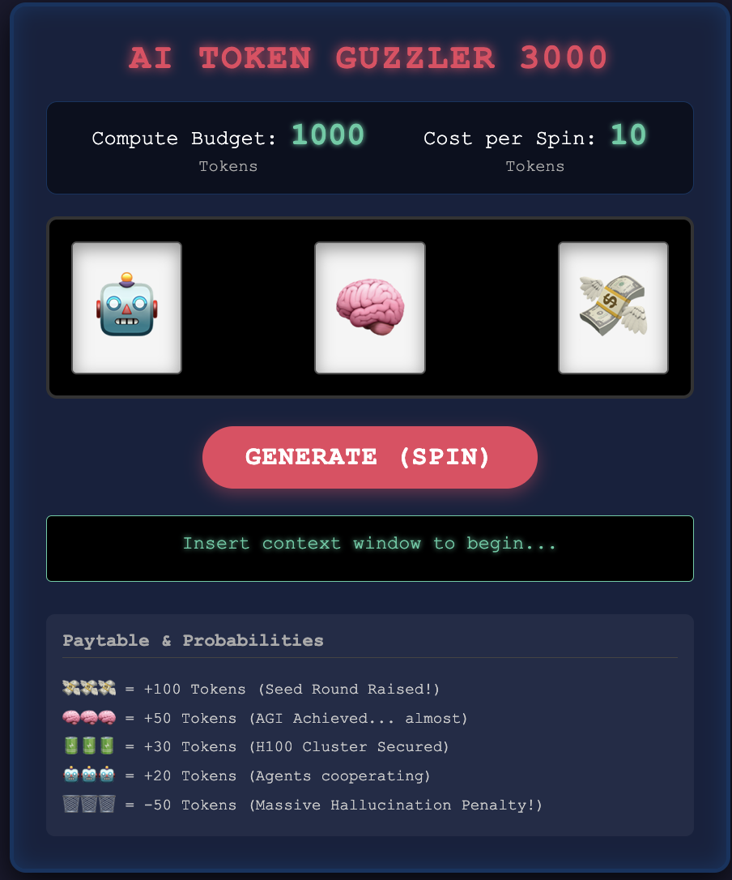
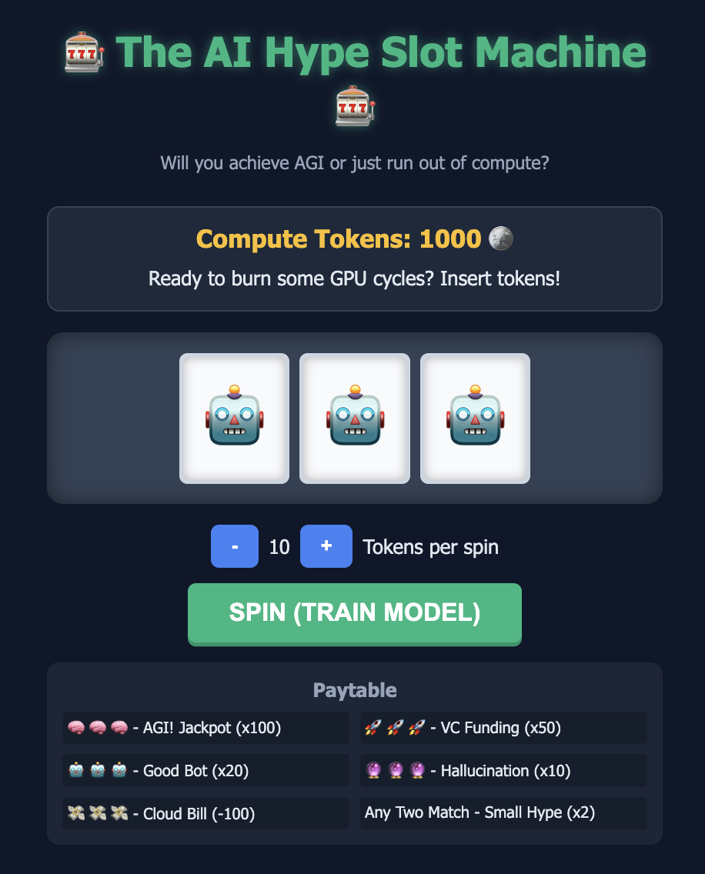
Phase 2 - First Runs
Wide variety in visuals, animations, and features across 50 iterations
Code quality and structure varied
Notes:
Iban
Those are 3 random runs that show the variation between each one
Choose the one that had the most unique mechanics, such as ability to change tokens, smooth visuals,

Slide 4
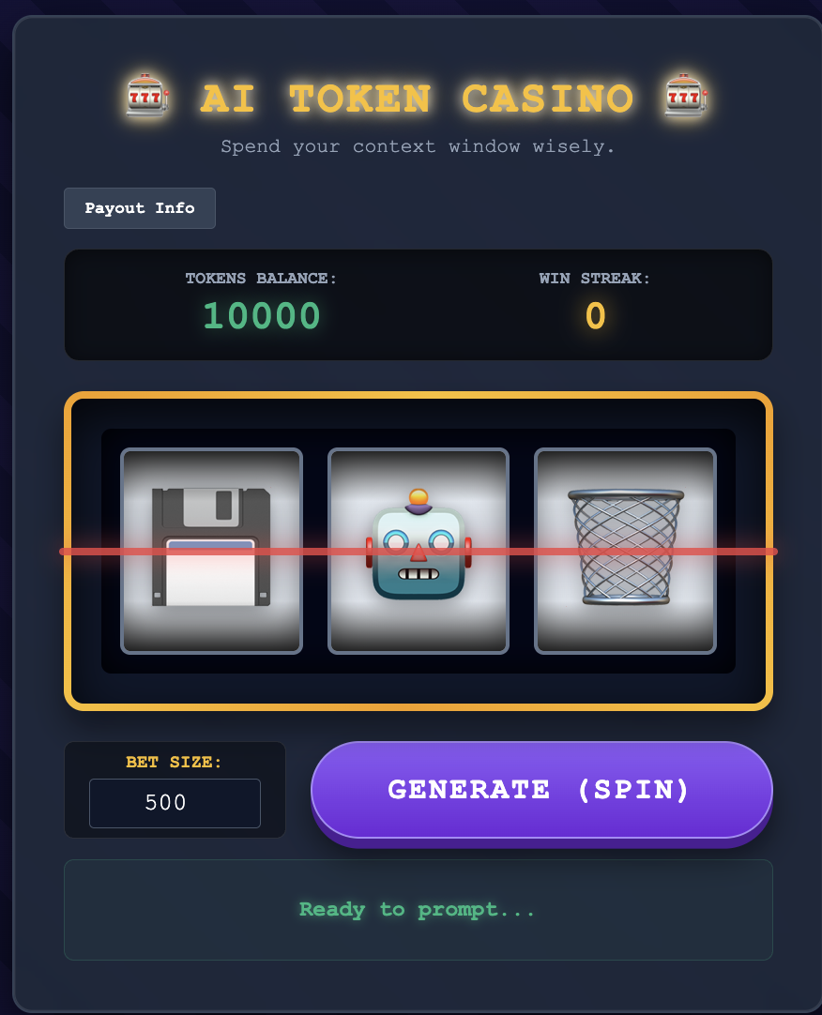
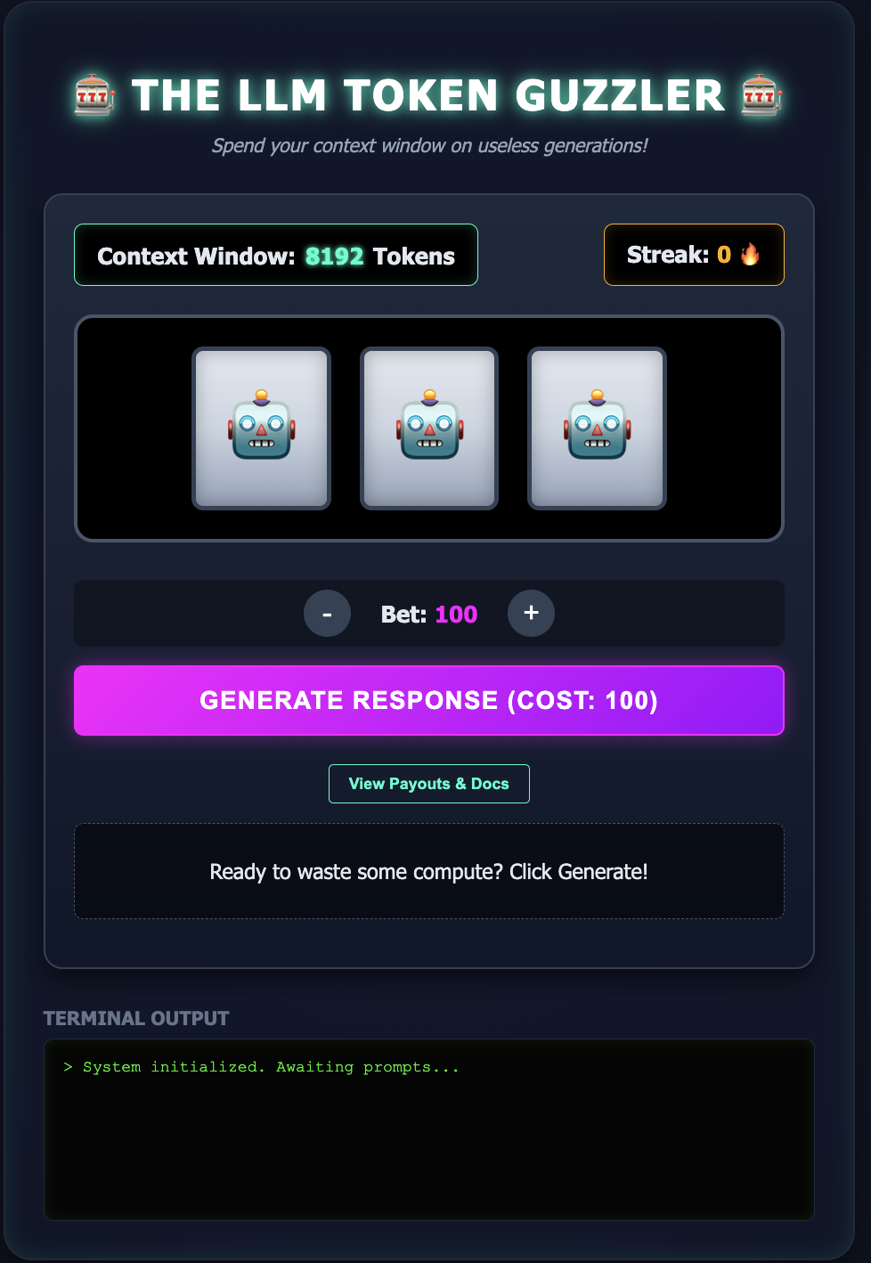
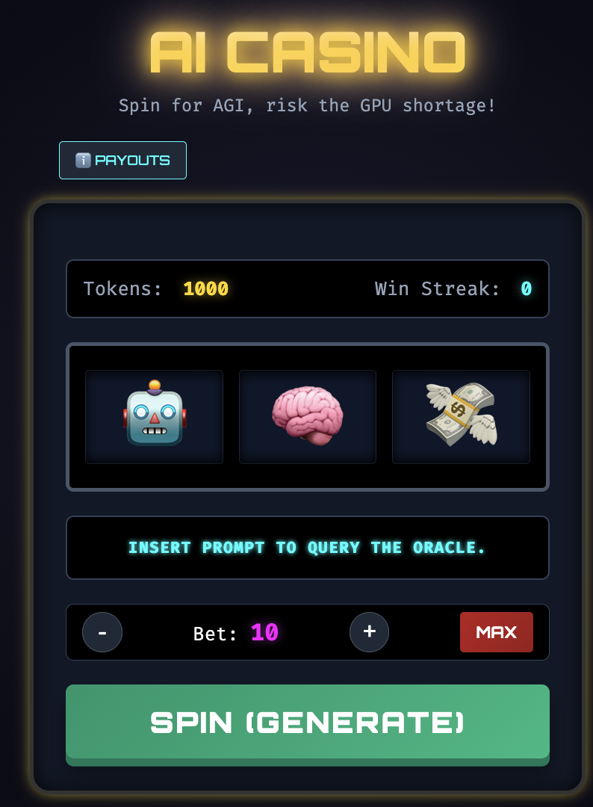
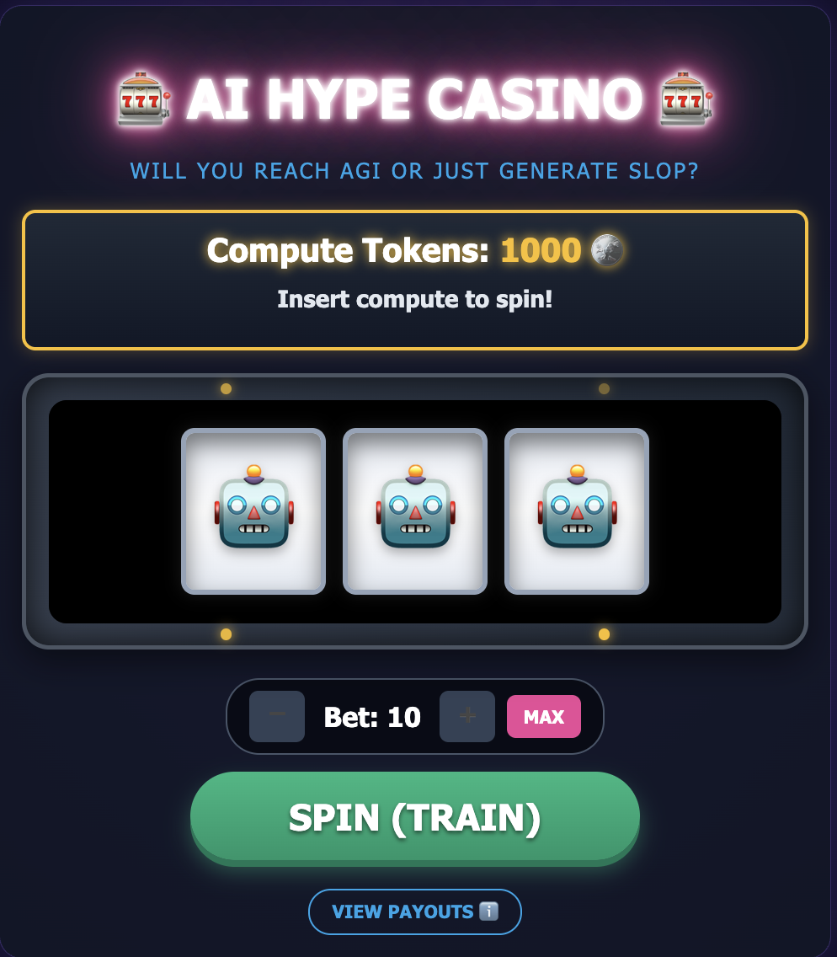
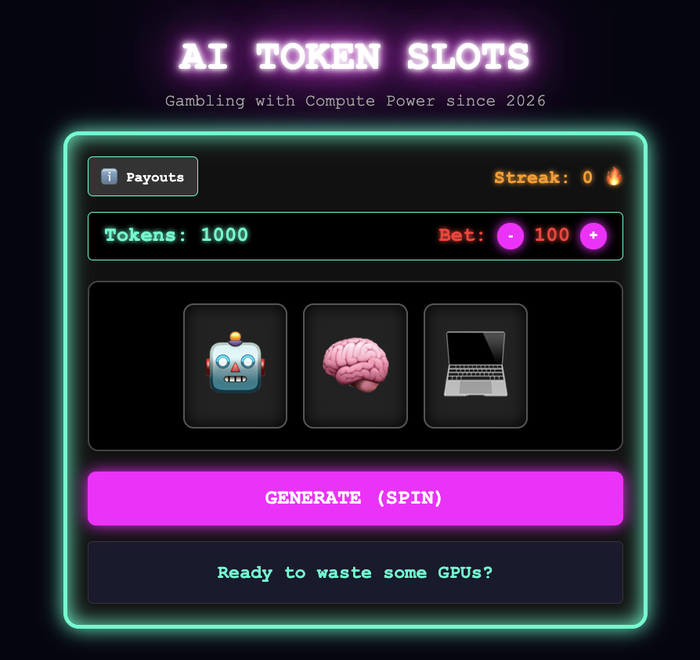
Phase 3A - Top 5
Top 5 selected based on visuals, functionality, and creativity
Top 5 then refined: sound effects, more flashy animations, add payout table, reset tokens, streak bonuses, AI jokes
Notes:
Iban
TOP 5
Candidate 1, has an option to choose the amount to gamble
Candidate 11, good neon visuals overall
Candidate 13, Terminal Output visual is unique.
Candidate 24, very good animation
Candidate 49, has sound, good looking as well
Used these features to develop our refinement prompt

Slide 5
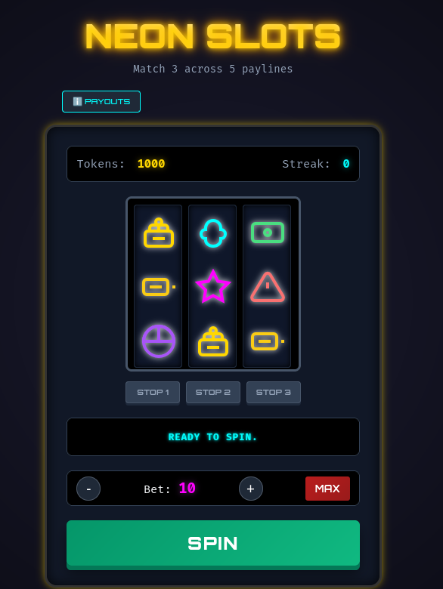
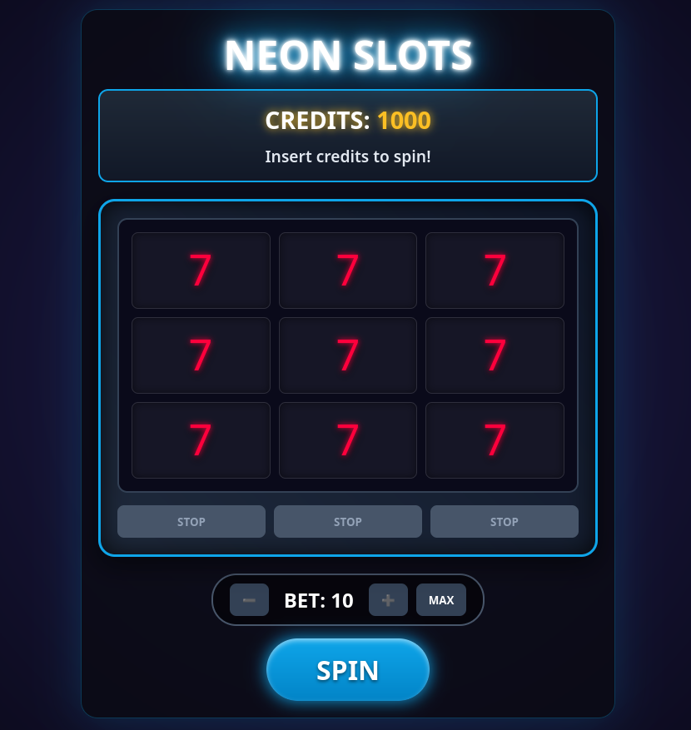
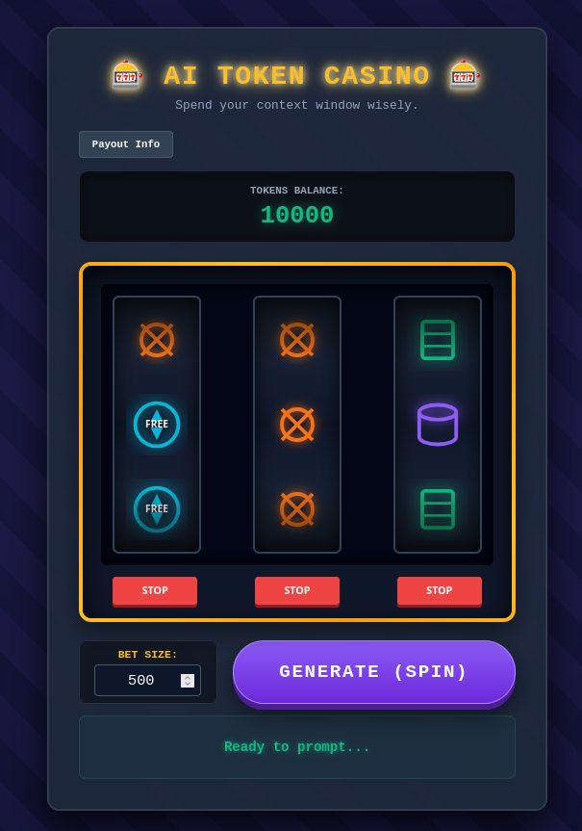
Phase 3B - Top 3
Features requested in refinement: New SVG glowing icons, 3x3 grid, big win screen, neon paylines, additional wild card symbols, ‘Win Anticipation’
Notes:
Abas

Slide 6

Phase 4 and 5 - Final Candidate
Notes:
Iban
Why we choose our final candidate:
Other candidates had glaring issues with audio and animations. We decided to focus our final refinement on improvements rather than fixes.

Slide 7
Final Findings
Refinement Works!
With each iteration, we saw a decent jump in features
Little Difference in Code Quality
Once the code was made a certain way it was hard to correct
Depth vs Breadth
Stuff Breaks
Narrow in on what features you want, as the LLM does best with direct tasks over ambiguity
Keep an eye out and be aware when your prompts undo progress
Notes:
Abas

